Slide 1
Introduction to our Lens JBrowse2
Carolyn Caron
JBrowse2 Workshop – March 16, 2026

Slide 2
Schedule
1) Introduction to JBrowse2
Basic navigation
How to add your own dataset as a local track
Sharing your view / Exporting as SVG
How to view synteny between different genome assemblies
Tips + Tricks
2) Case studies by Rob Stonehouse
Break!
3) Live demonstration
Adding a local GWAS track
Time permitting: Any requests?
Adding our own phenotypic trait data to an existing variant track

Slide 3
What to expect:
We are walking through our instance of JBrowse of Lens genomes, which is hosted on KnowPulse
Therefore, I won’t be covering how to setup your own JBrowse instance and add tracks to it.
If you are interested in this process, reach out to me outside of this workshop!
Feel free to ask me questions at any time!
Especially if you are following along and can’t find a specific setting/button
If you would like me to demonstrate anything from this introduction directly on JBrowse, make a note of it and we can revisit it at the end.

Slide 4
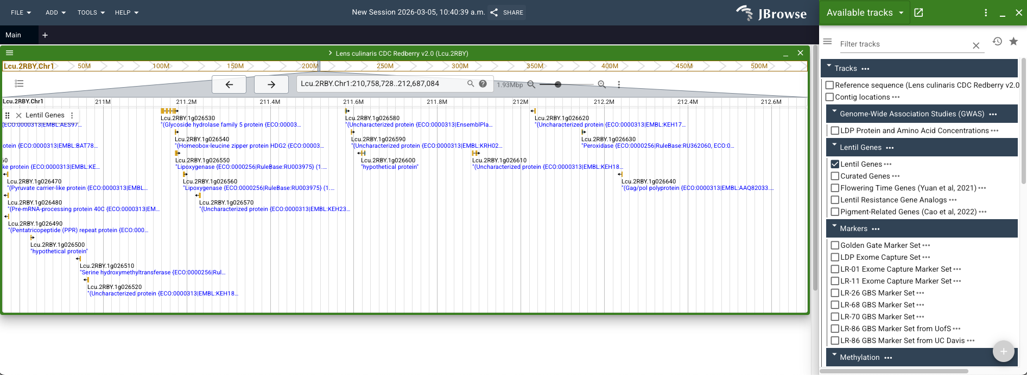
What is JBrowse2?
An interactive interface for browsing genomic features such as genes, transcripts, and variants.
Gives you the ability to customize the display, export views and add your own data tracks.

Slide 5
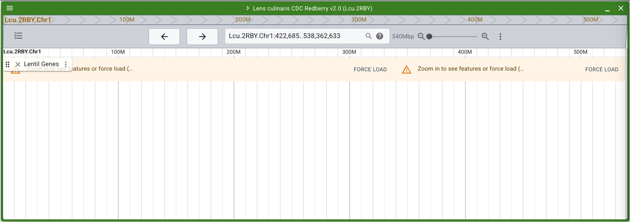
Navigation
Notes:
Many tracks won’t show up without zooming in closer. There are a few ways to zoom in JBrowse

Slide 6
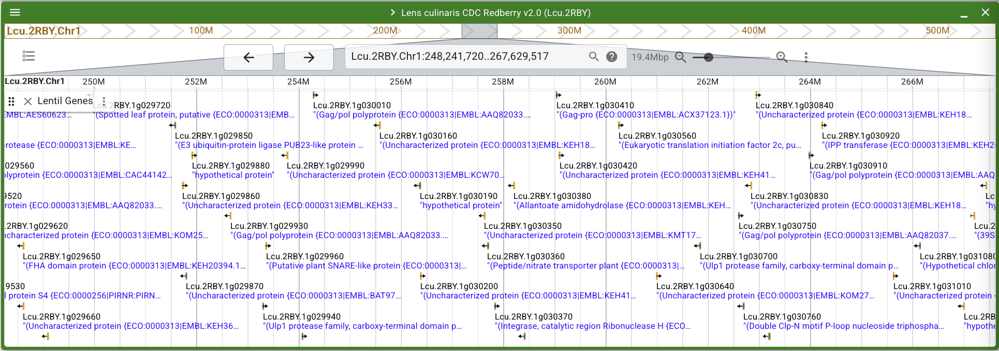

Navigation
Click and hold to highlight a region of the chromosome

Slide 7
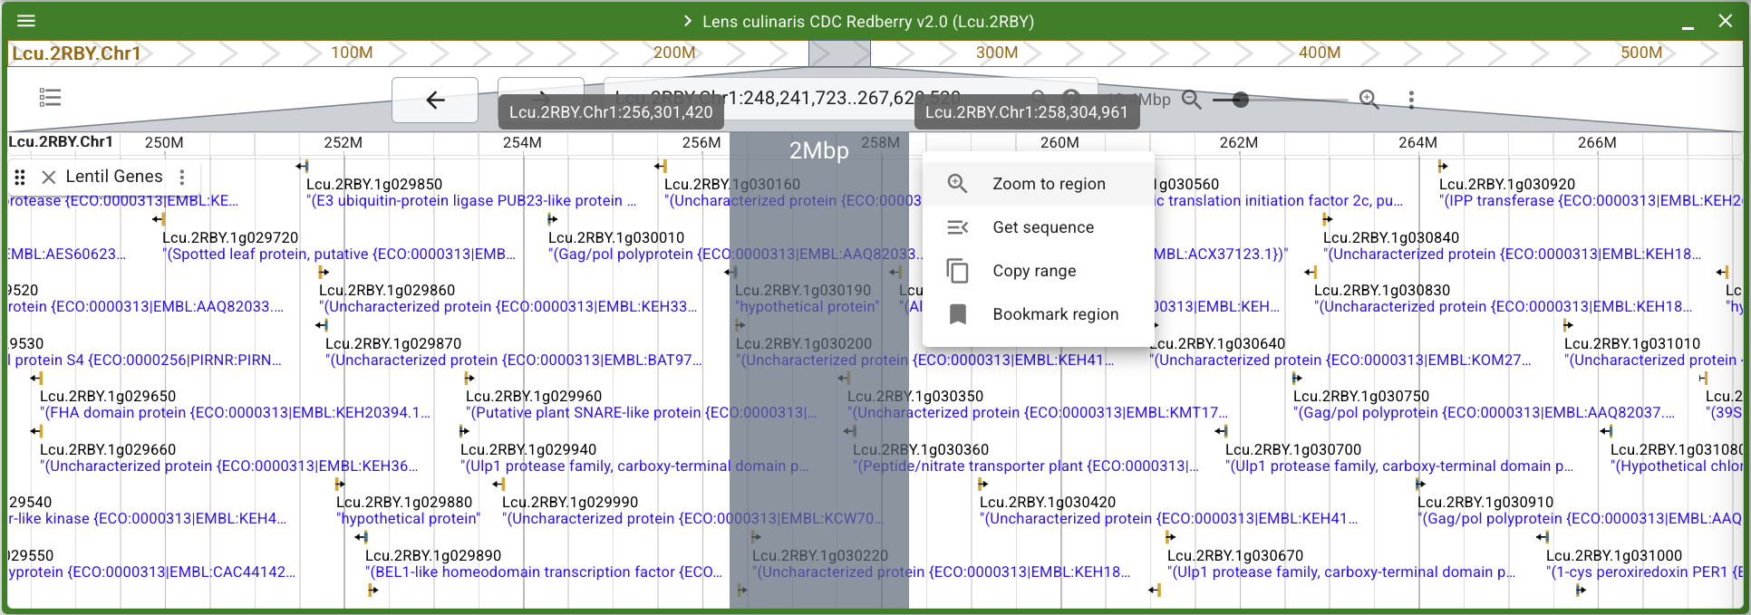
Navigation
Click and hold to highlight a region of the current view

Slide 8
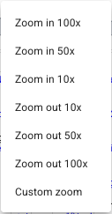
Navigation
Click and hold to highlight a region of the chromosome
Arrows shift the current view to the left or right
Zoom in or out by 2x

Slide 9
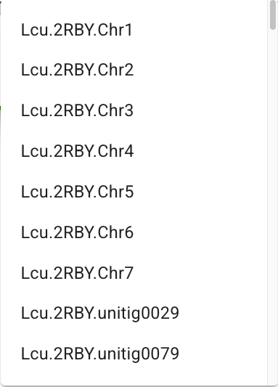
Navigation
Click and hold to highlight a region of the chromosome
Click to see the various chromosomes and scaffolds available

Slide 10
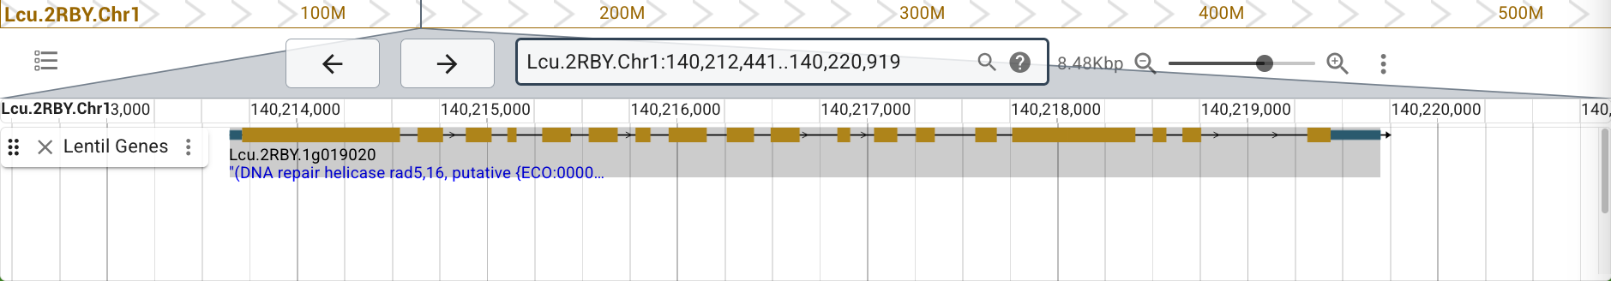
Navigation
Searching for features (eg. genes)
Click and hold to highlight a region of the chromosome
This is also a search bar! You can search by position, range, or even features such as gene names!
Click here for many search examples!
Enter your gene of interest and hit enter, the gene track will automatically open for you and take you to that gene.

Slide 11
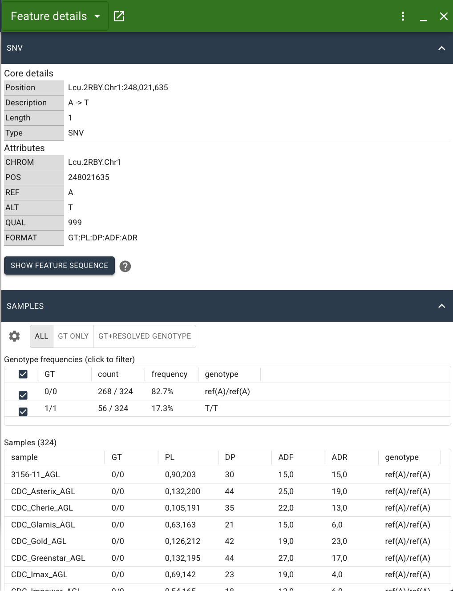
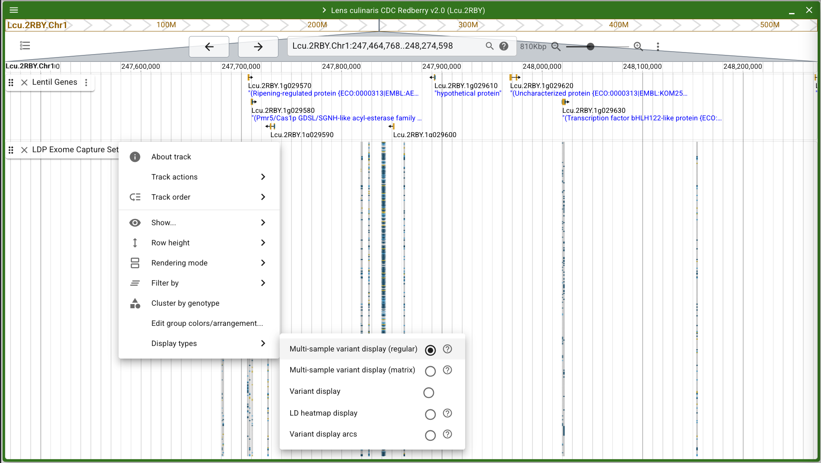
Navigation
You will see question marks next to many areas and settings within JBrowse – click on these to see help text to guide you.

Slide 12
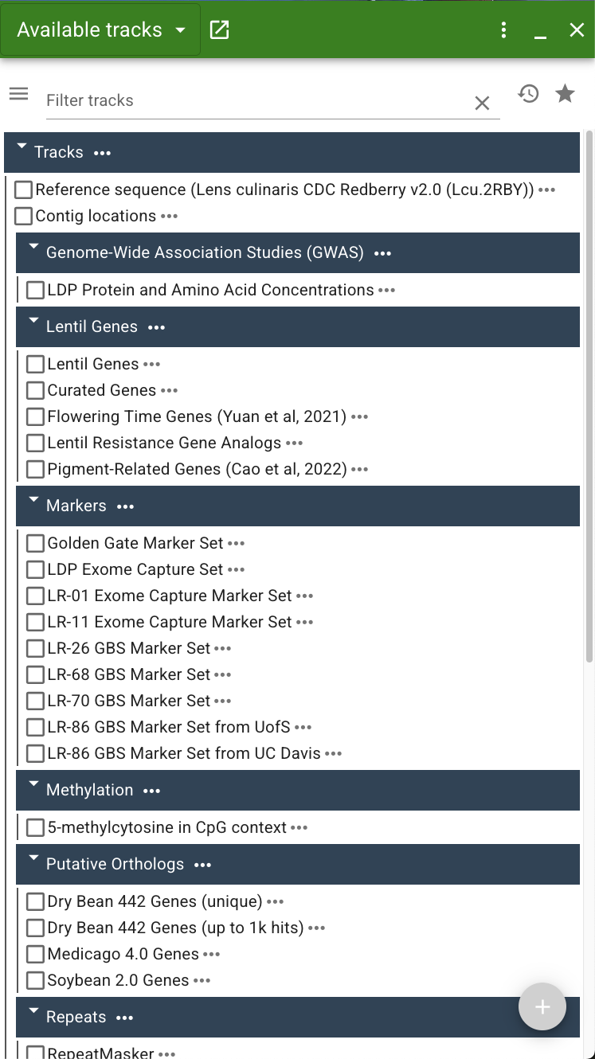
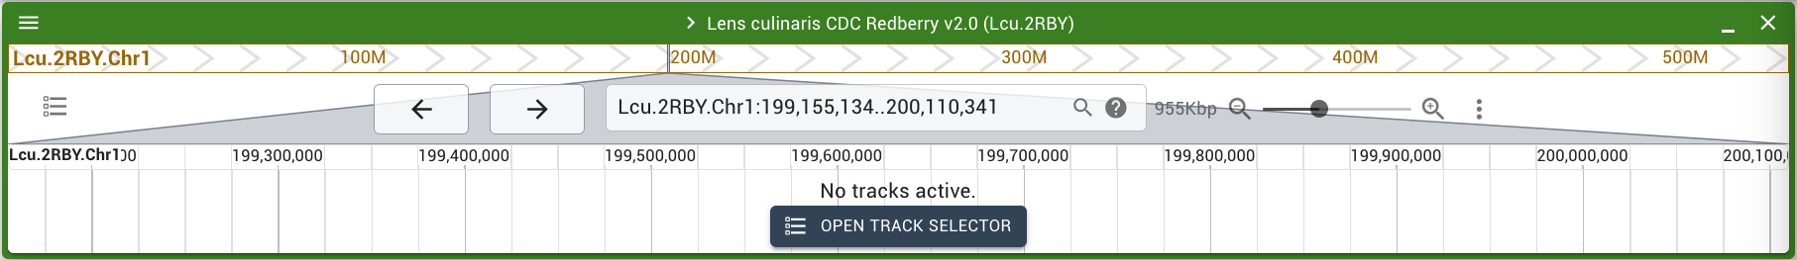
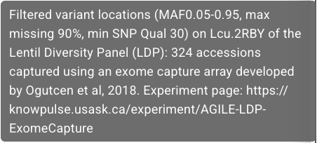
Navigation
The Track Selector

Slide 13
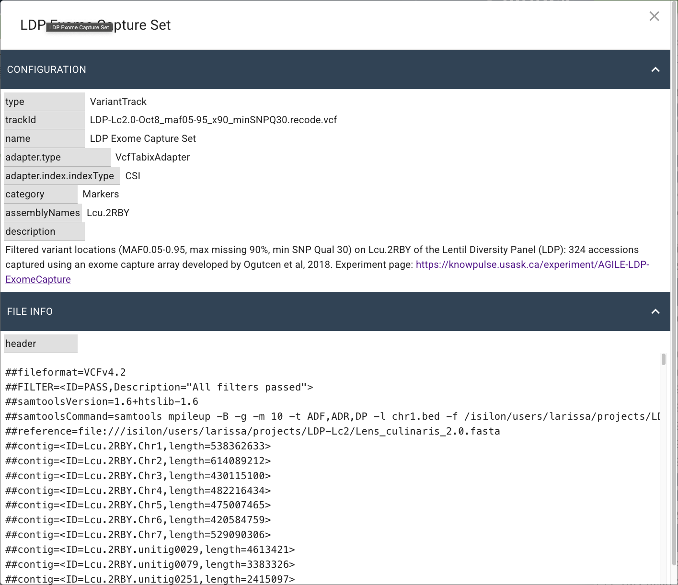
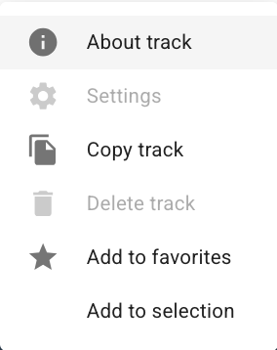
Navigation
The Track Selector

Slide 14
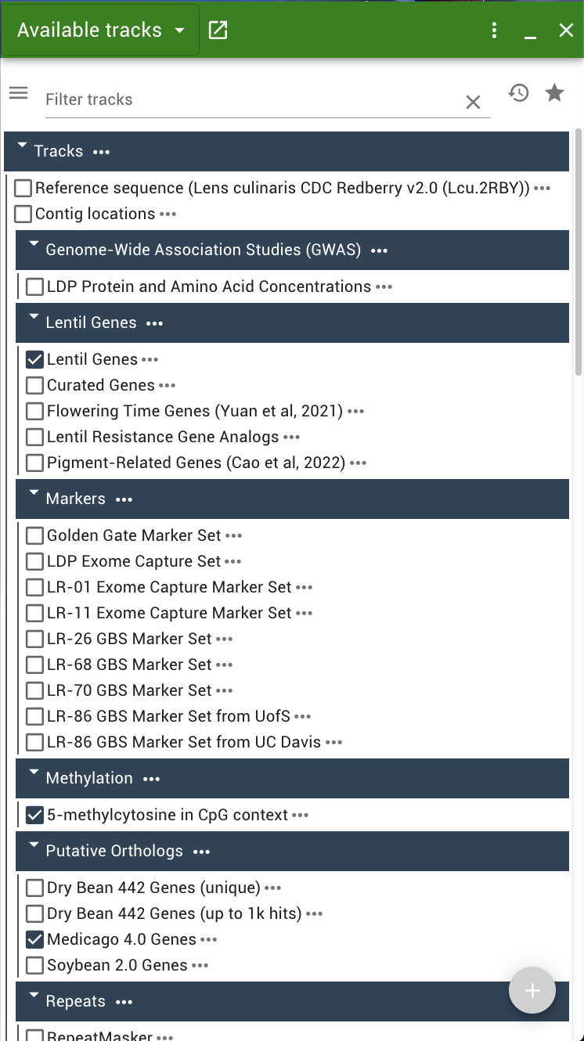
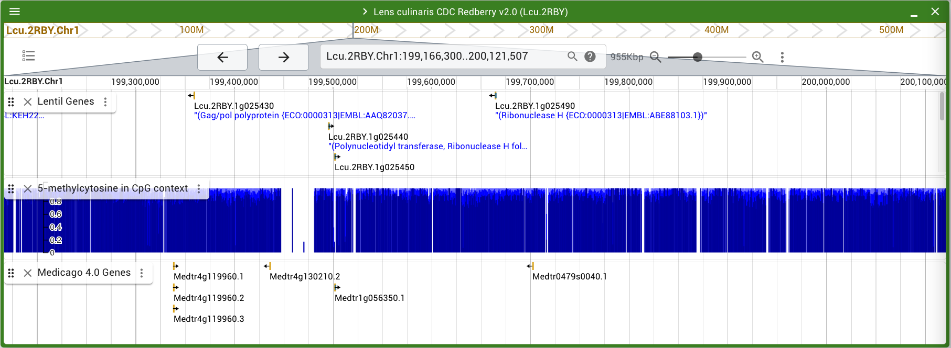
Navigation
The Track Selector
Tracks can be reordered by clicking left of the track name and drag-and-drop it where you want it to go.
Track size is adjustable by clicking and dragging below the track

Slide 15
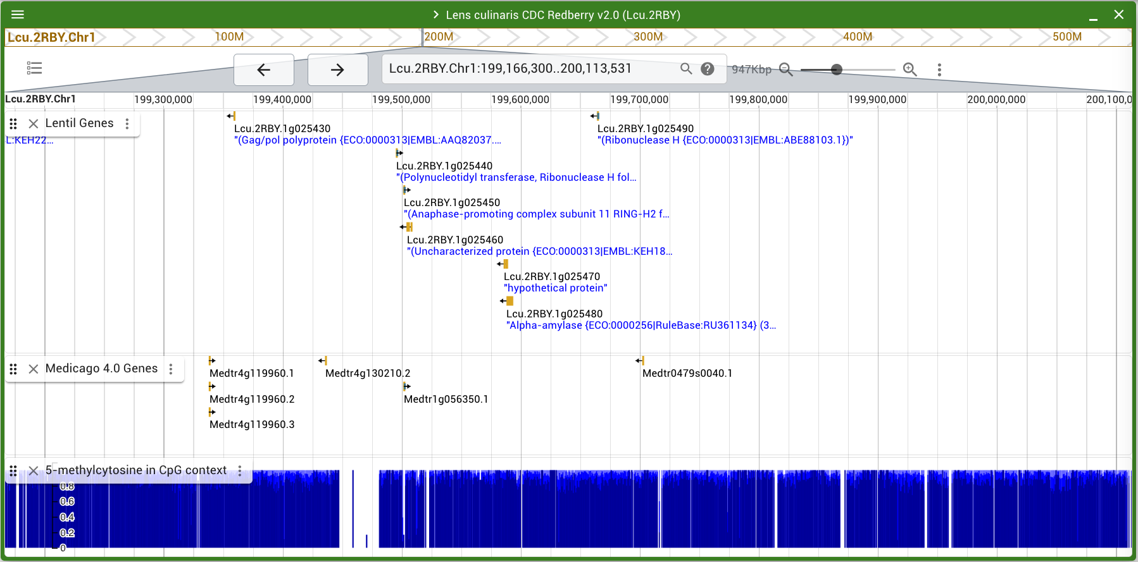
Navigation
The Track Selector

Slide 16
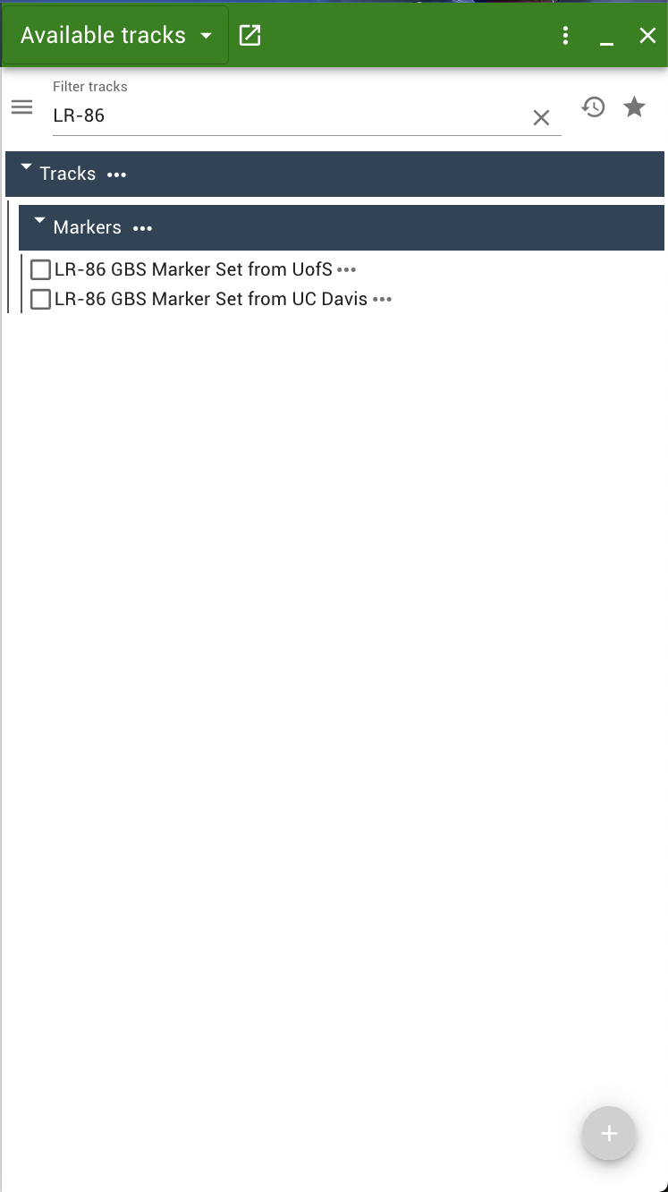
Navigation
The Track Selector
Tracks are searchable at the top of the track selector.
Keep in mind that already selected tracks will remain open.
To go back to the entire track list, click on the “X” within the search bar.

Slide 17

Navigation
The Track Selector
Or, you can always get back to the track listing by clicking this icon:

Slide 18
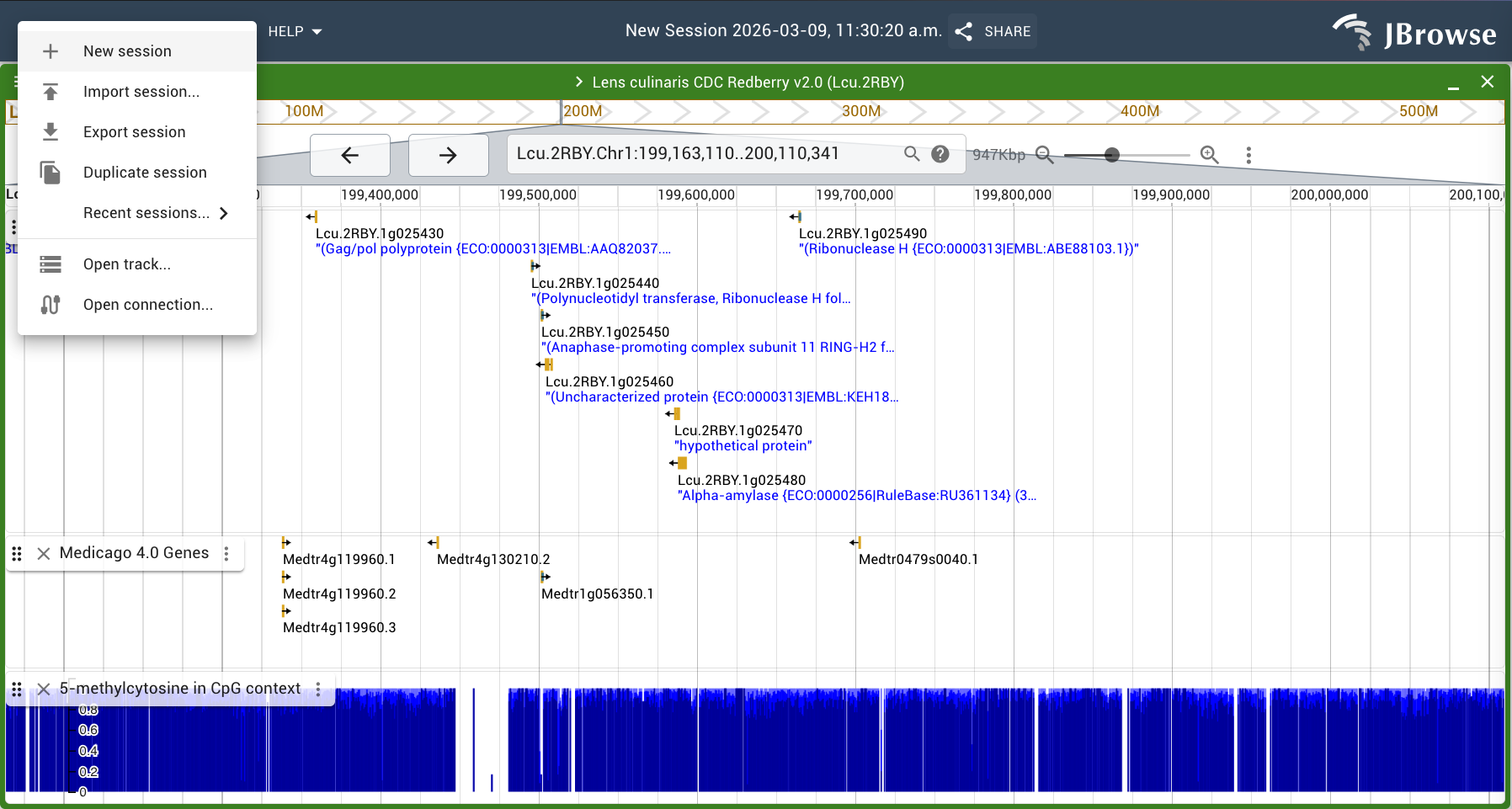
Navigation
Starting a New Session
If you want to start a new session to go to a different assembly or just to start fresh, click “FILE” in the JBrowse toolbar and + New Session

Slide 19
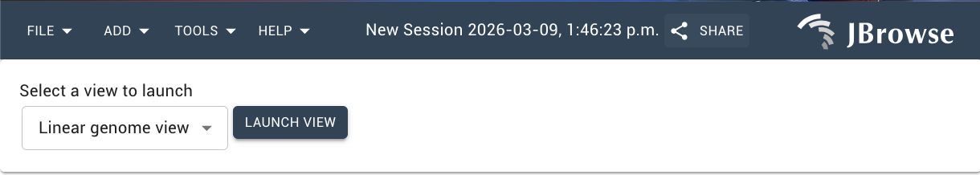
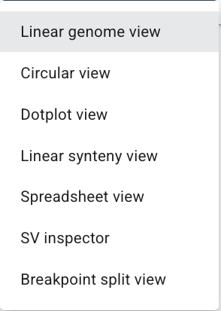
Navigation
Starting a New Session
In most cases, you’ll want a “Linear genome view”.

Slide 20
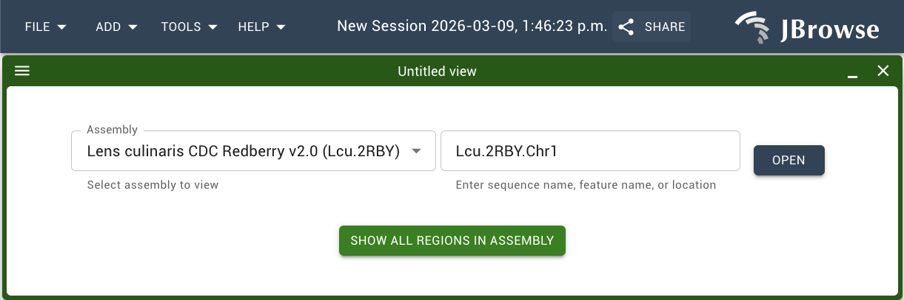
Navigation
Starting a New Session
Select your assembly, then:
Choose a chromosome/scaffold + click “OPEN”
Or choose “SHOW ALL REGIONS IN ASSEMBLY”

Slide 21
Navigation
Genes/Orthologs
RNA-Seq
Oligo-FISH
RepeatMasker +
EDTA Repeats
Whole Genome + Centromeric Satellites
When to view by chromosome
Centromere Peaks
When to view by all regions in assembly
Markers/Variants
Methylation
Read Alignments
Synteny
GWAS Results

Slide 22
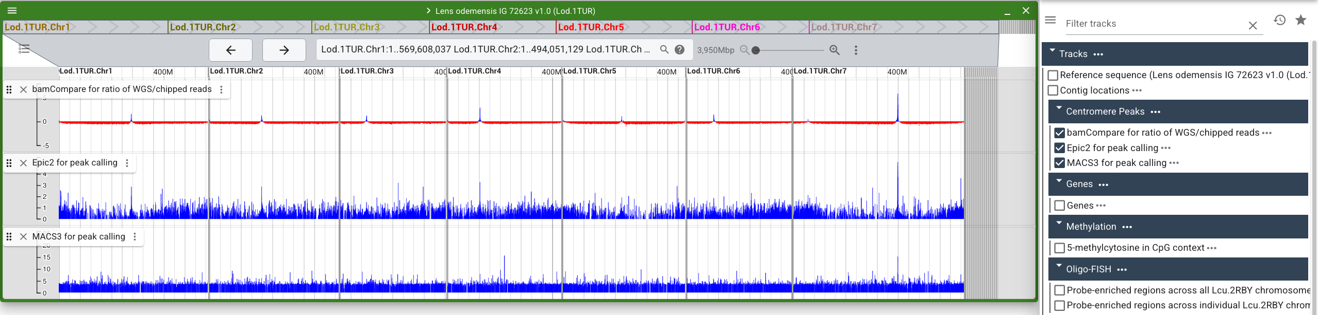
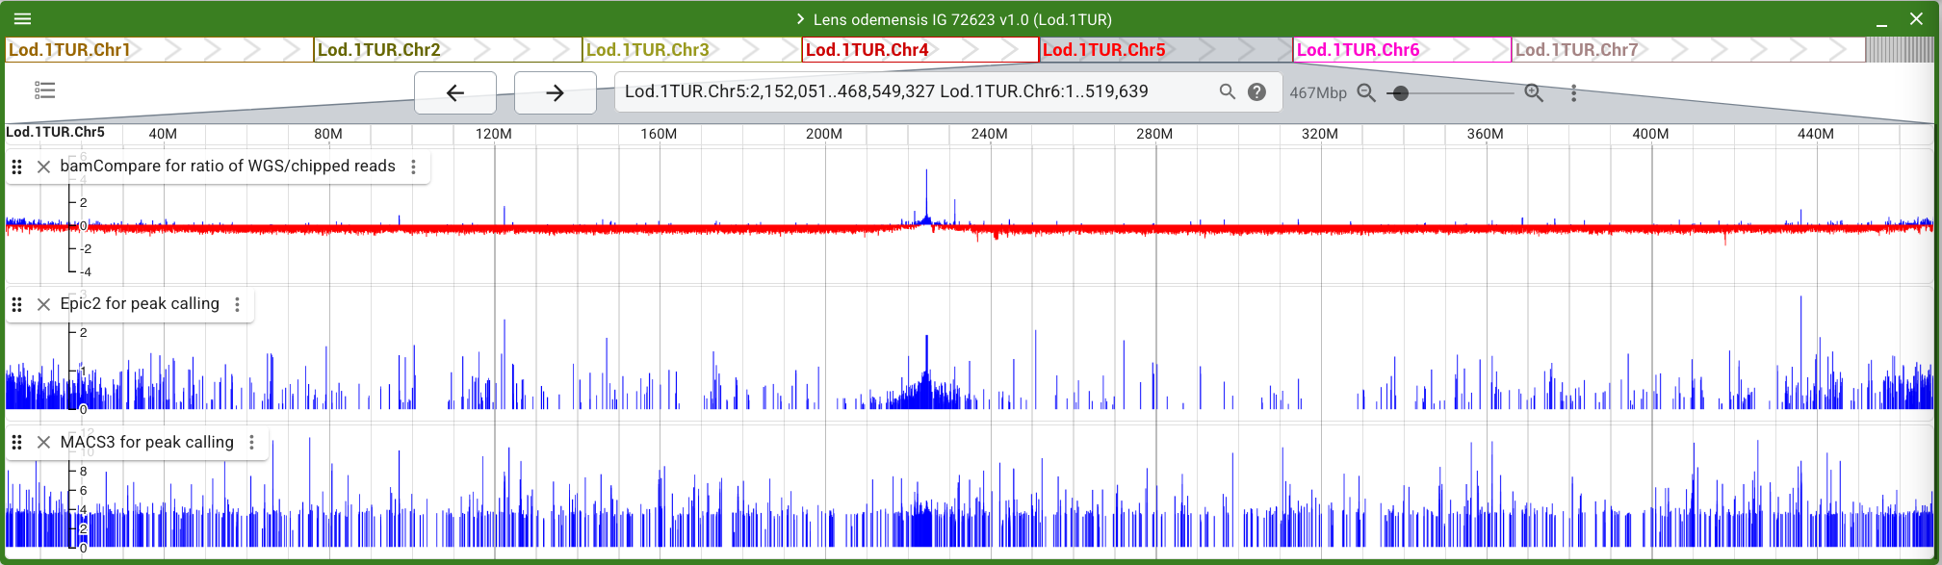
Navigation
Example 1: Looking at Centromere Peaks
Notes:
Analysis of Centromere peaks was done by Alex Silvestrini using three different software/methods. He explained to me that all 3 tracks should be selected at a time, and to combine the evidence from all 3 to determine the likelihood of a centromere’s position.

Slide 23
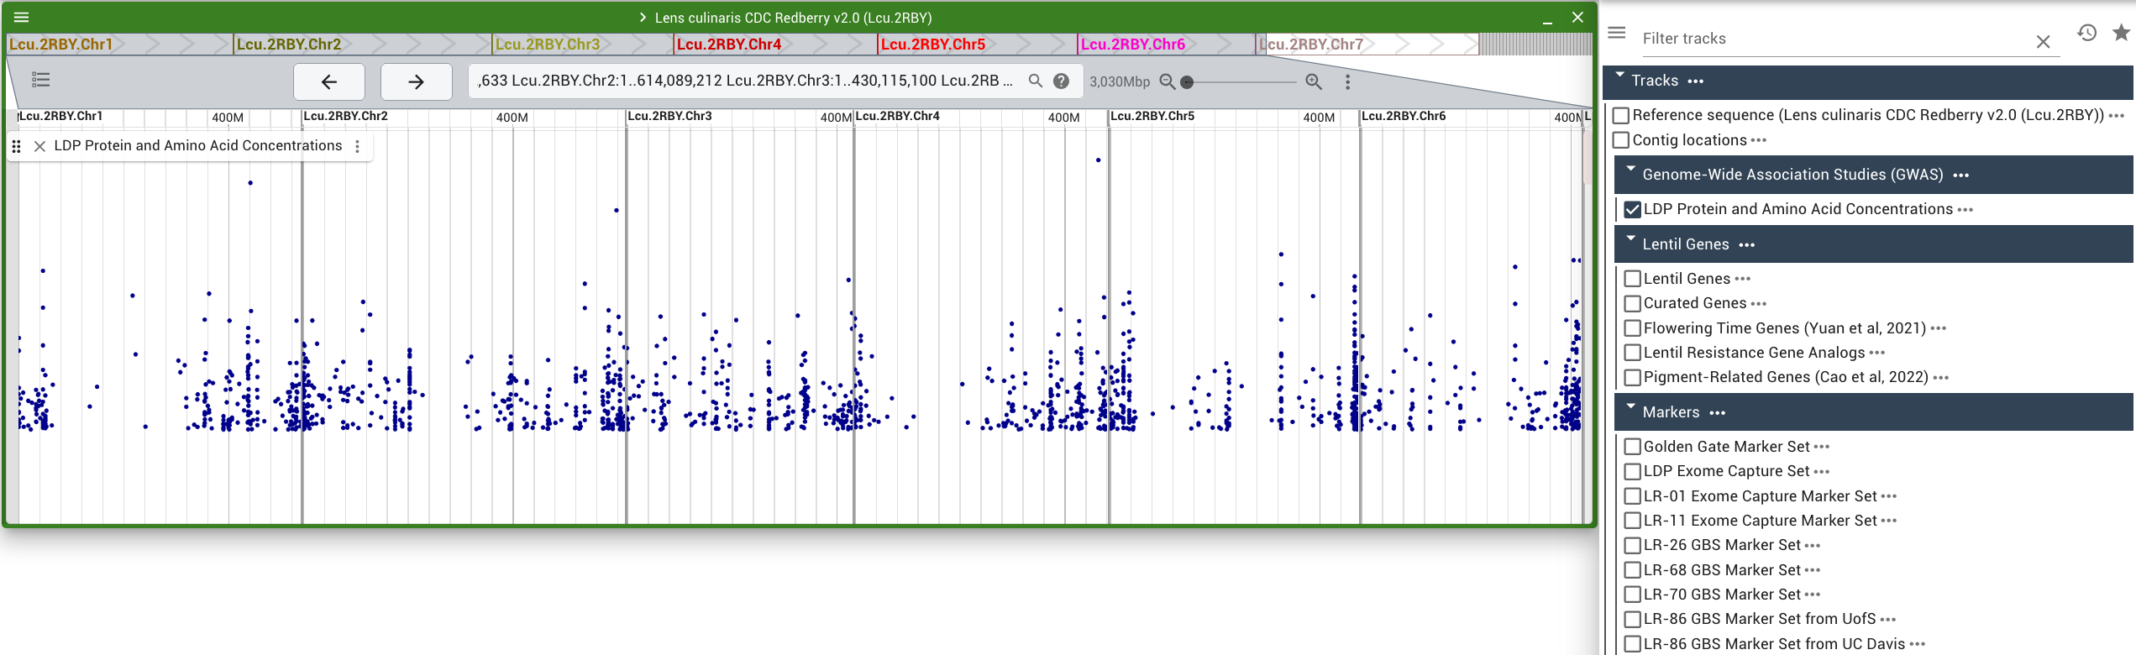
Navigation
Example 2: Looking at GWAS Results

Slide 24
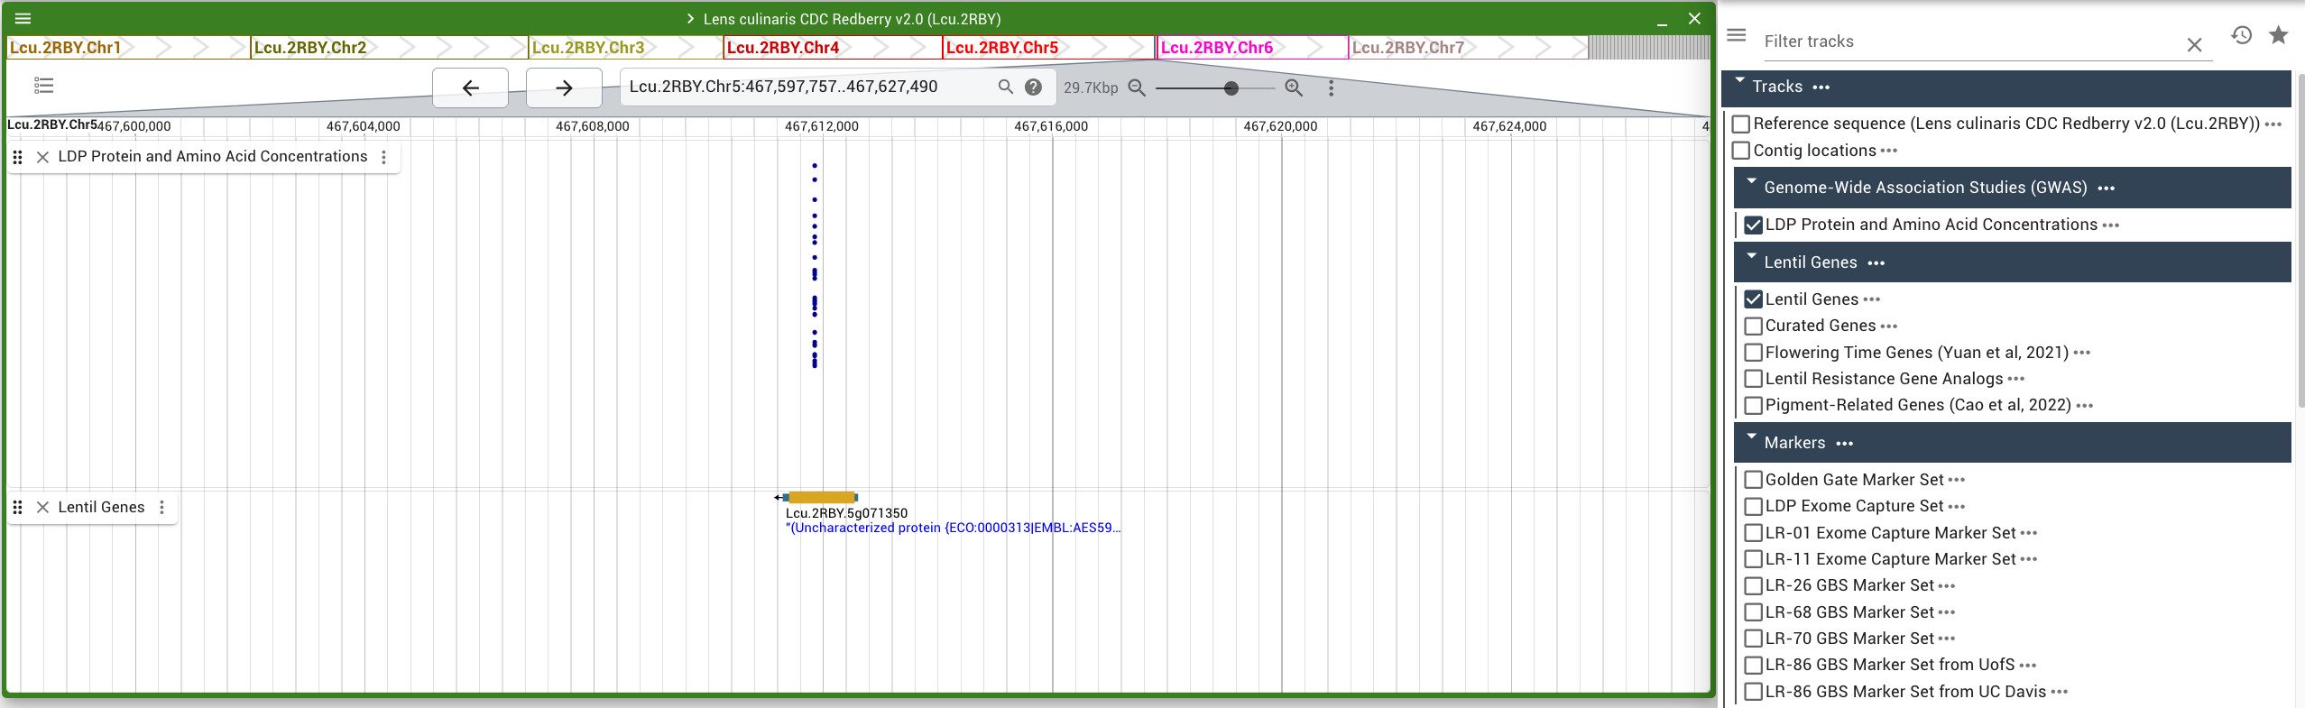
Navigation
Example 2: Looking at GWAS Results

Slide 25
Uploading Your Own Track
What are the common formats?
Format | Description | Examples of uses
GFF3 | Standardized tab-delimited format for sequence features | Genes
FASTA | Sequence format, JBrowse pulls from the headers (>) rather than the sequence itself | Reference sequence, Genes, general features already in FASTA format
BED | Tab delimited text file for adding various features with only 3 required columns – the most flexible format | GWAS results, BLAST results, general features
VCF | Standardized format for variants | SNPs, indels, structural variants
BAM/CRAM | Compressed read alignment format | Synteny, RNA-seq, pre-SNP calling
BigWig | Binary format for dense, continuous data | RNA-Seq, Methylation

Slide 26
Uploading Your Own Track
Before uploading, check your chromosome names!
All of our JBrowse assemblies use a standardized format for chromosome names. This looks like:
[assembly name].Chr[chromosome #]
Your file will not be visible as a track unless these names match. This is the most common reason you will encounter an error when uploading a track.

Slide 27
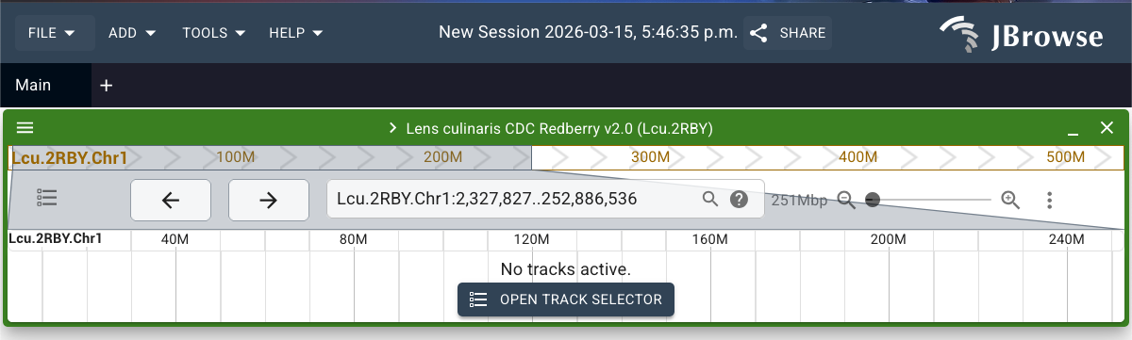
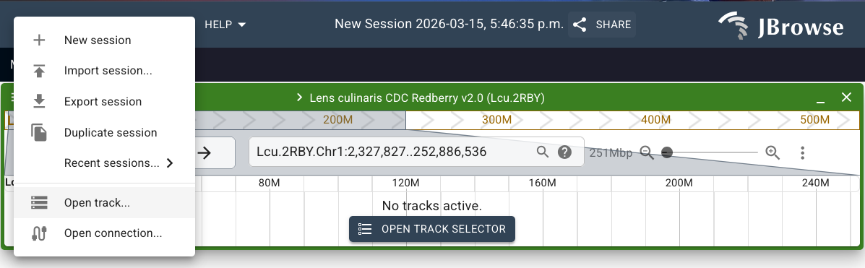
Uploading Your Own Track

Slide 28
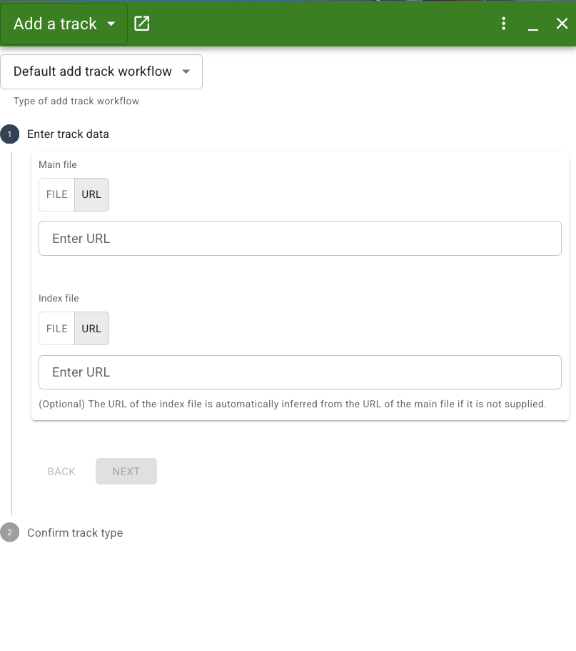
Uploading Your Own Track
Some track types need to be compressed using bgzip and indexed using tabix.
This is particularly true with LARGE files (ie. >100MB)!
Most likely though, this is not necessary. Try your file as-is first, just make sure it is one of the valid formats.

Slide 29
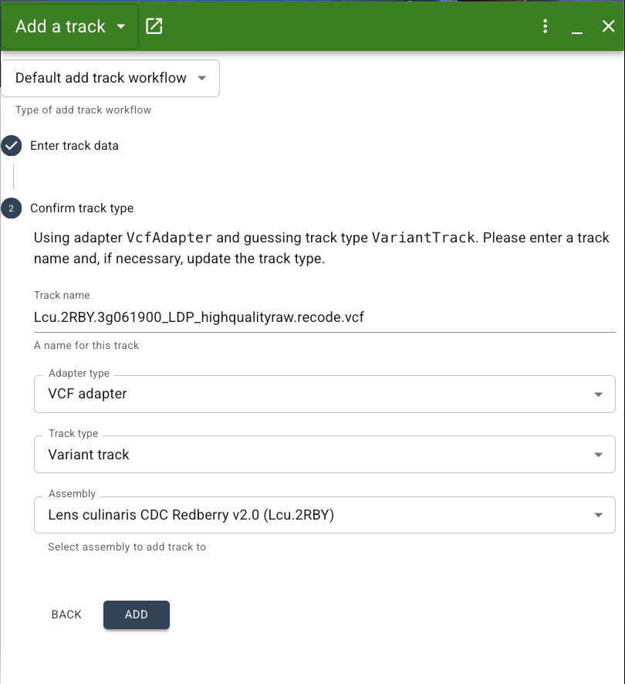
Uploading Your Own Track
Rename the track if you’d like here (optional)
JBrowse is pretty accurate in detecting the file type and choosing the Adapter type and Track type for you.
Double check that your track is on the right assembly

Slide 30
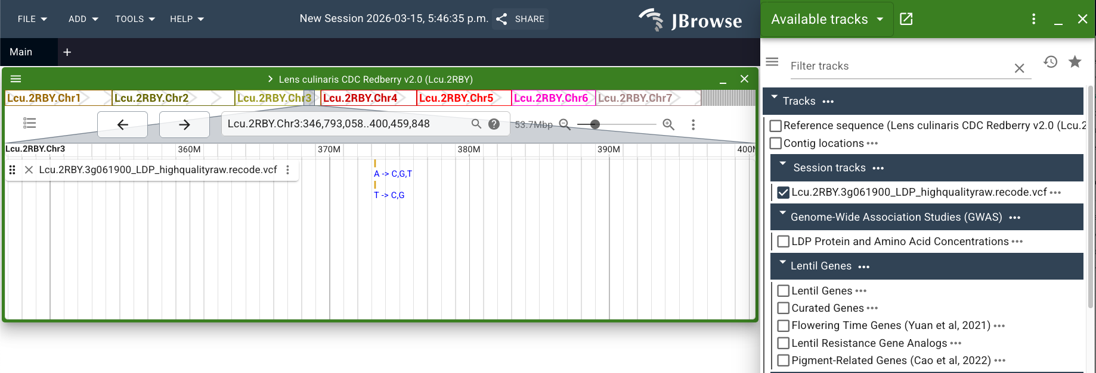
Uploading Your Own Track

Slide 31
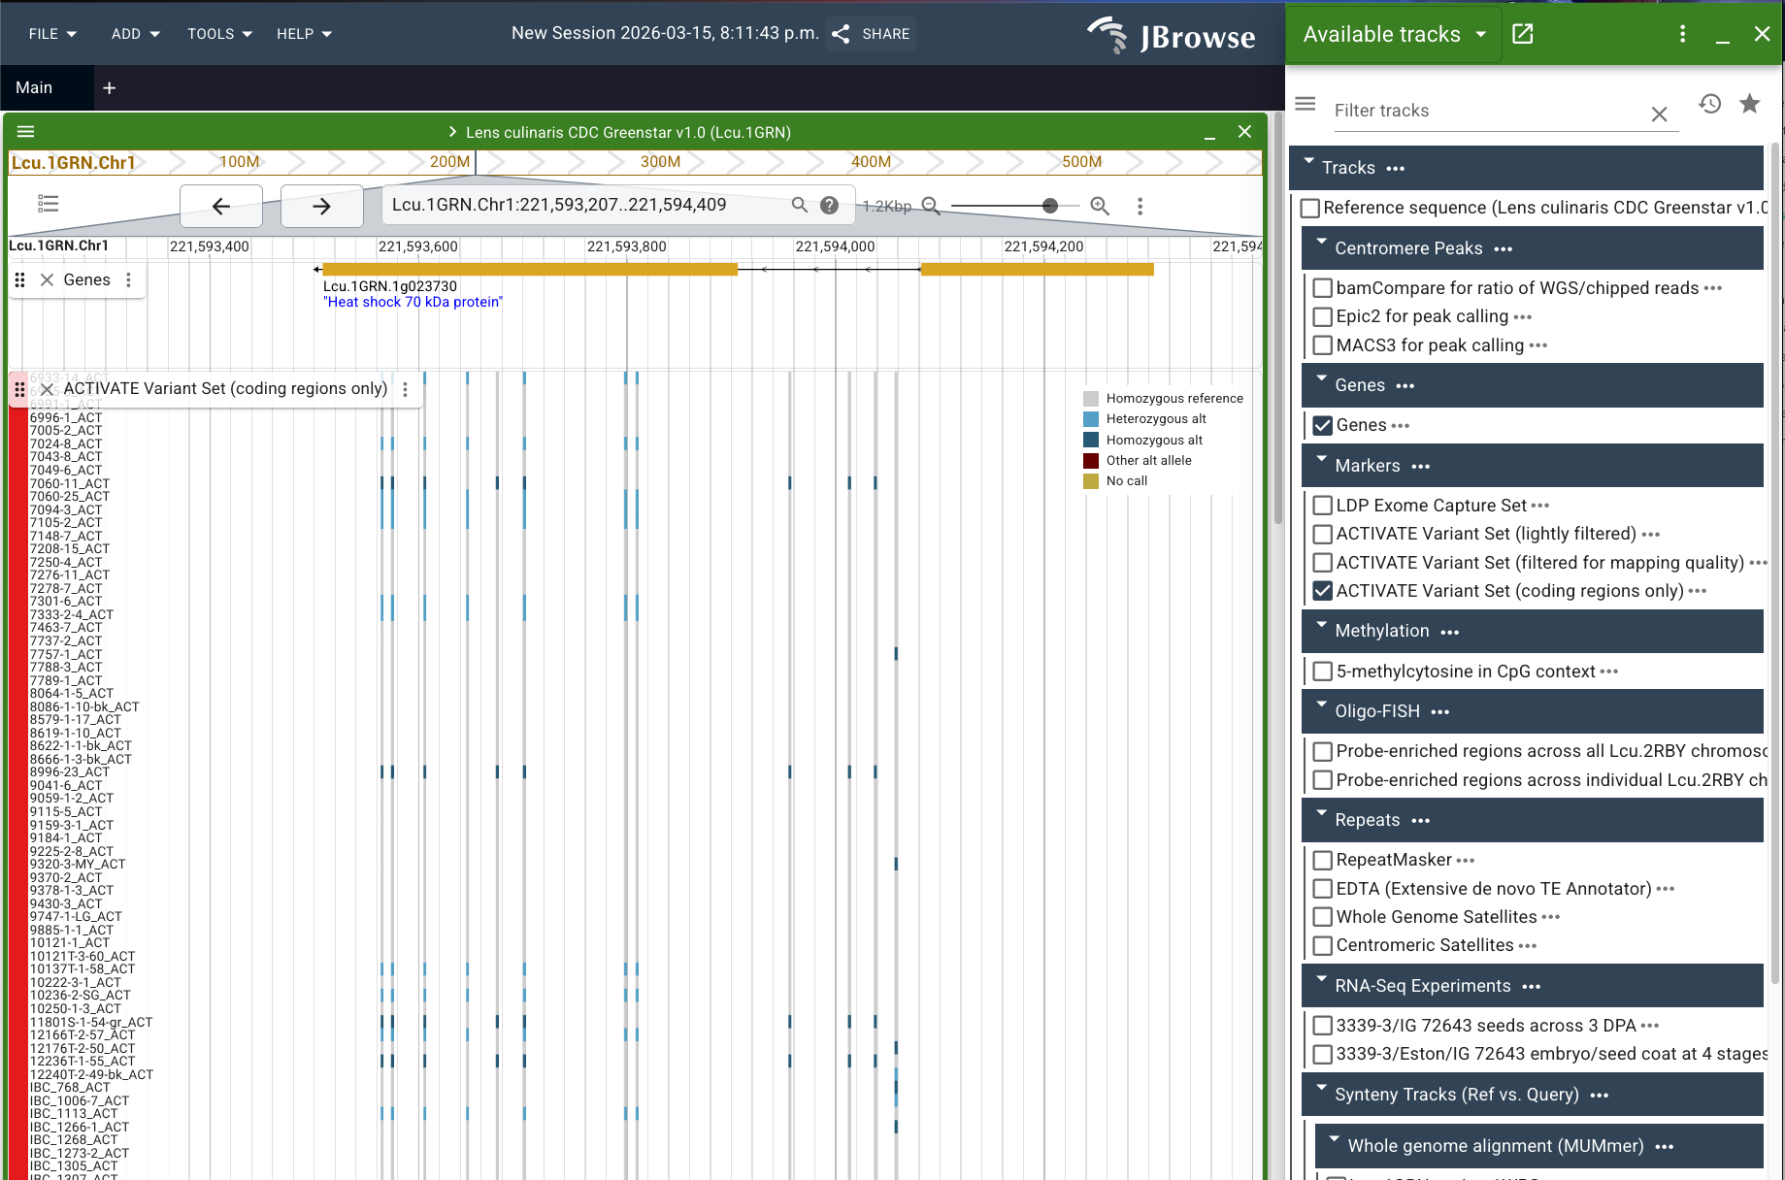
Sharing a View

Slide 32
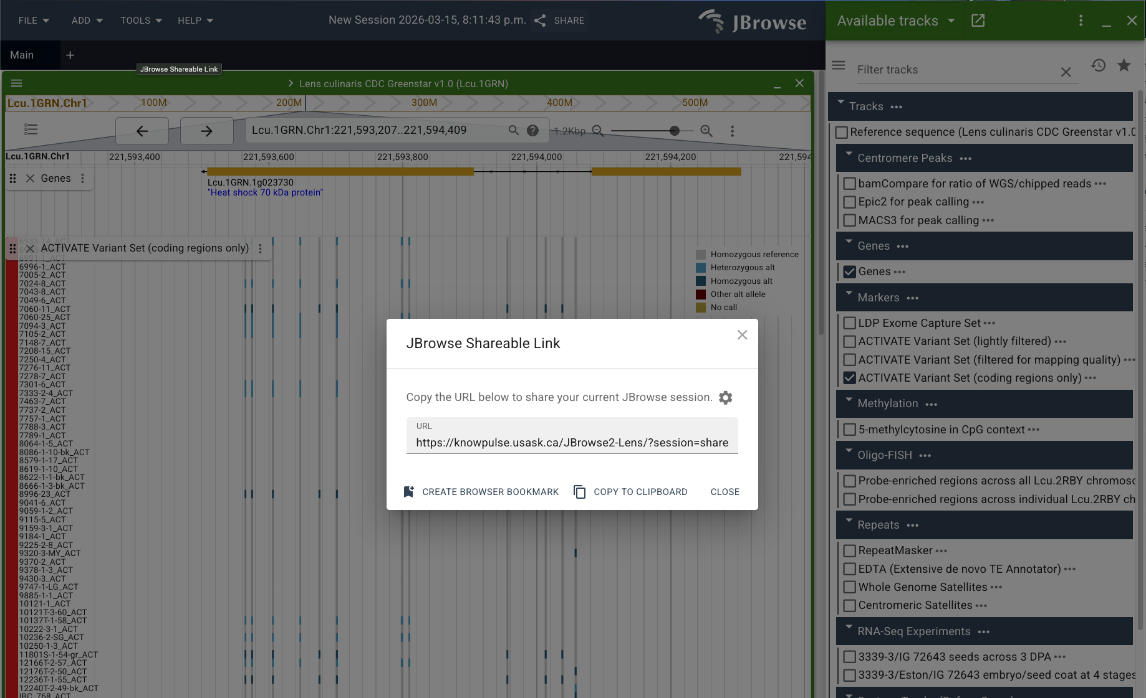
Sharing a View

Slide 33
Sharing a View
https://knowpulse.usask.ca/JBrowse2-Lens/?session=share-hR0RcDEh63&password=YfMWo

Slide 34
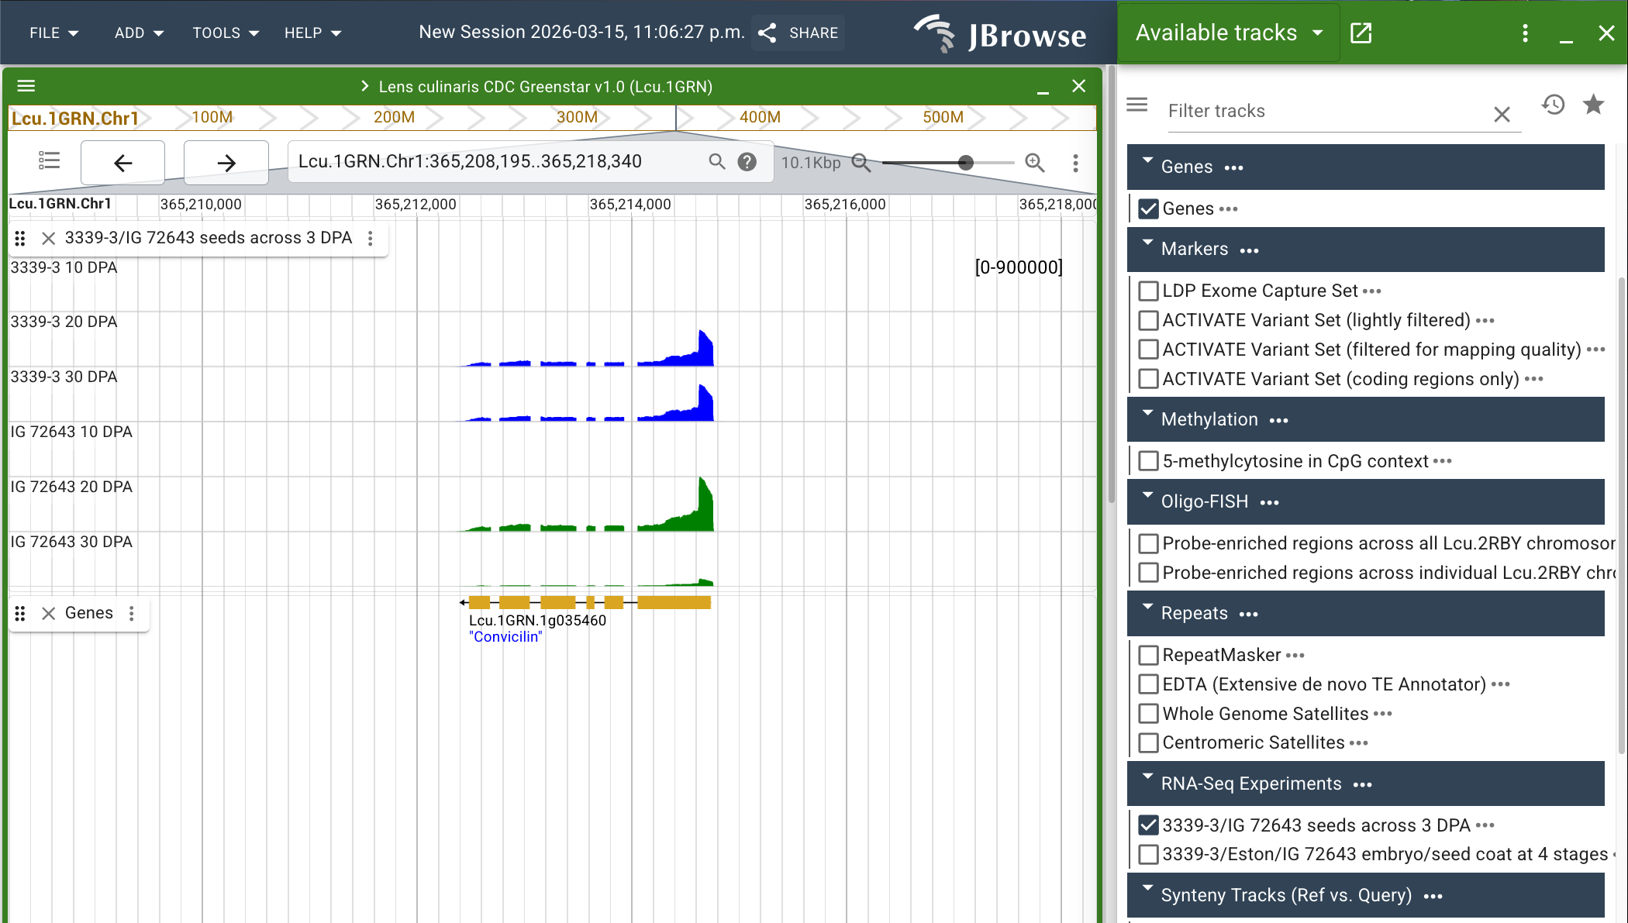
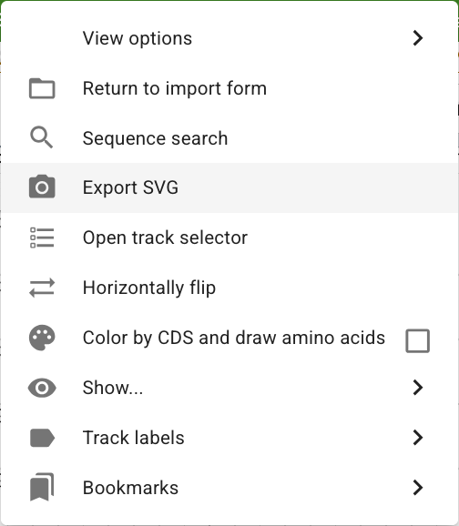
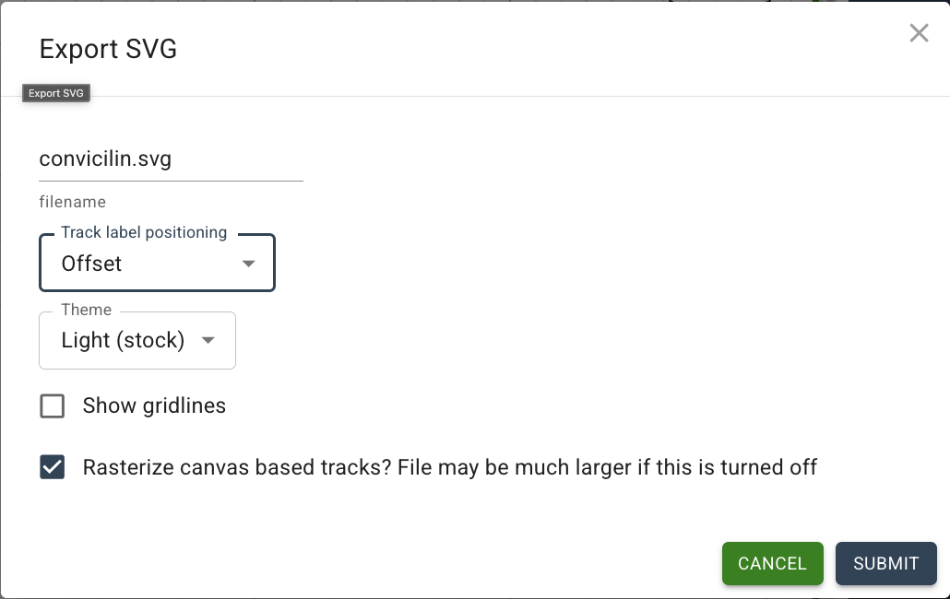
Exporting as SVG
Notes:
SUBMIT will automatically download the SVG in your browser. You can open it within your browser to view it.

Slide 35
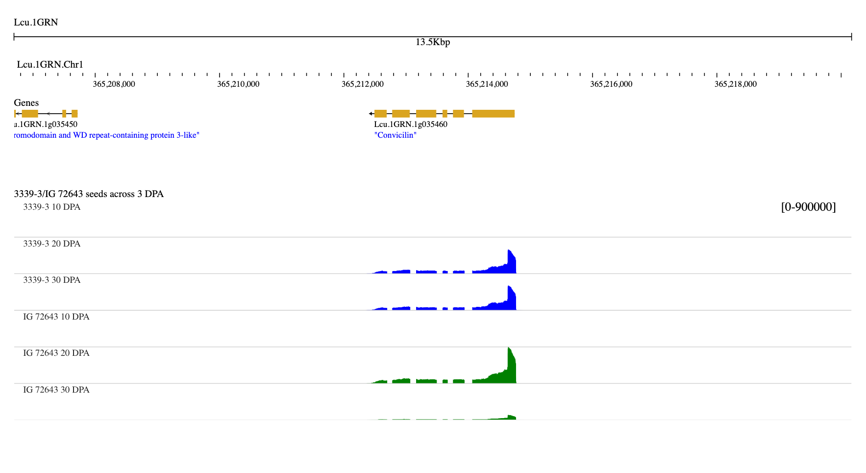
Exporting as SVG

Slide 36
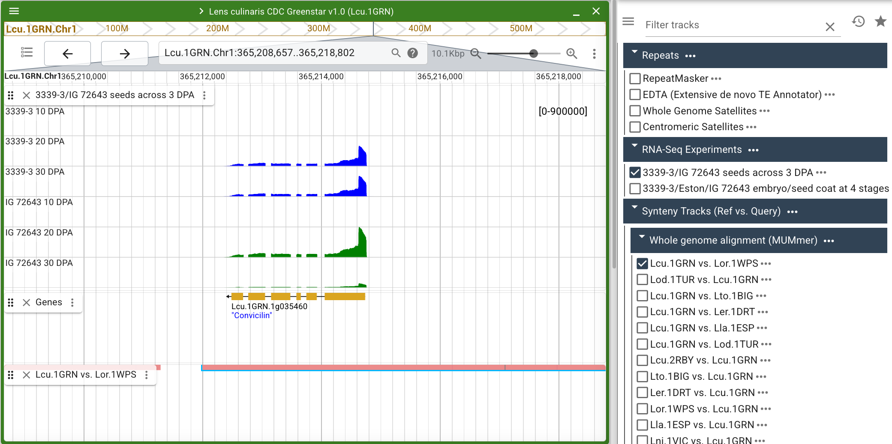
Exporting as SVG

Slide 37
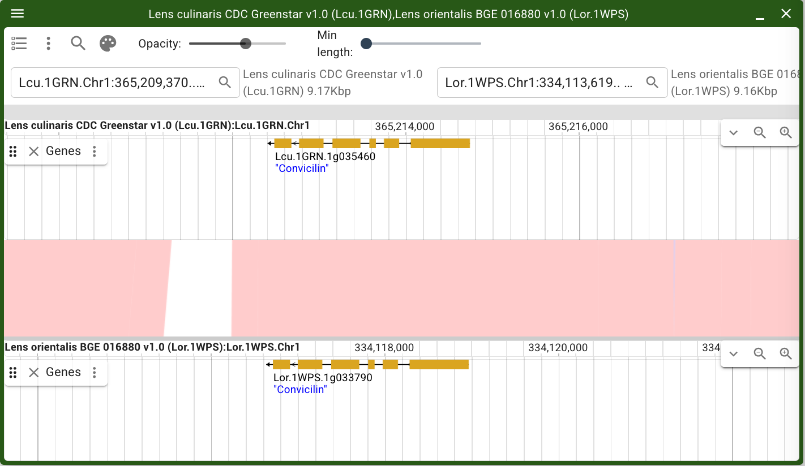
Exporting as SVG

Slide 38
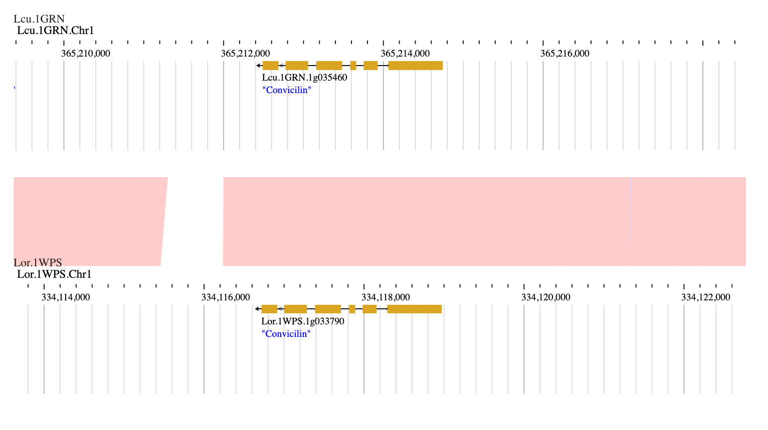
Exporting as SVG

Slide 39
Viewing Synteny
When do you want to view synteny?
To identify conserved genomic regions across genome assemblies
In a Linear Genome View, synteny is displayed as various “syntenic blocks” which are alignment hits with another genome assembly.
In a Linear Synteny View, both genomes are displayed at once with syntenic regions drawn to connect them.
You still have access to the full tracklist for each assembly!

Slide 40
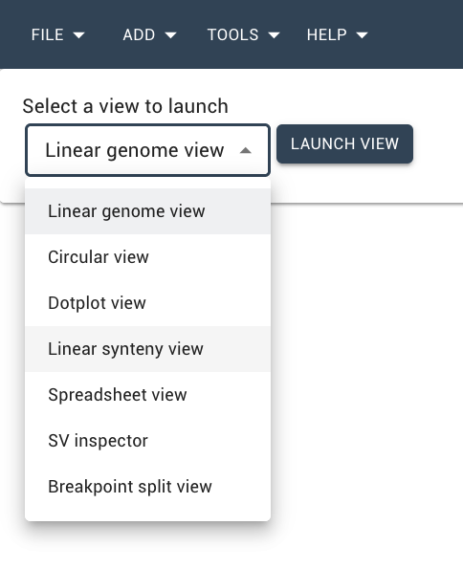
Viewing Synteny
You can start a new session and choose a Linear synteny view, BUT…
I highly recommend you start a Linear genome view and navigate to your feature(s) of interest first.

Slide 41
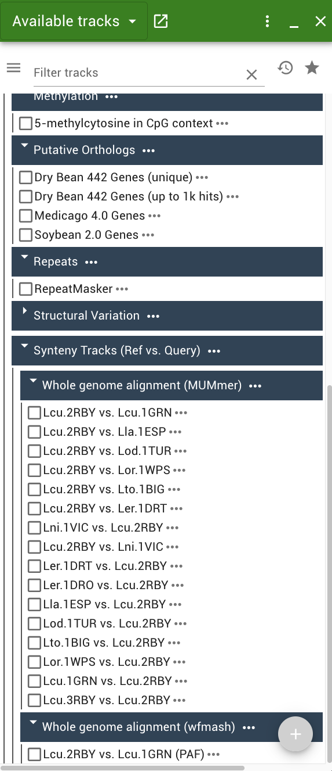
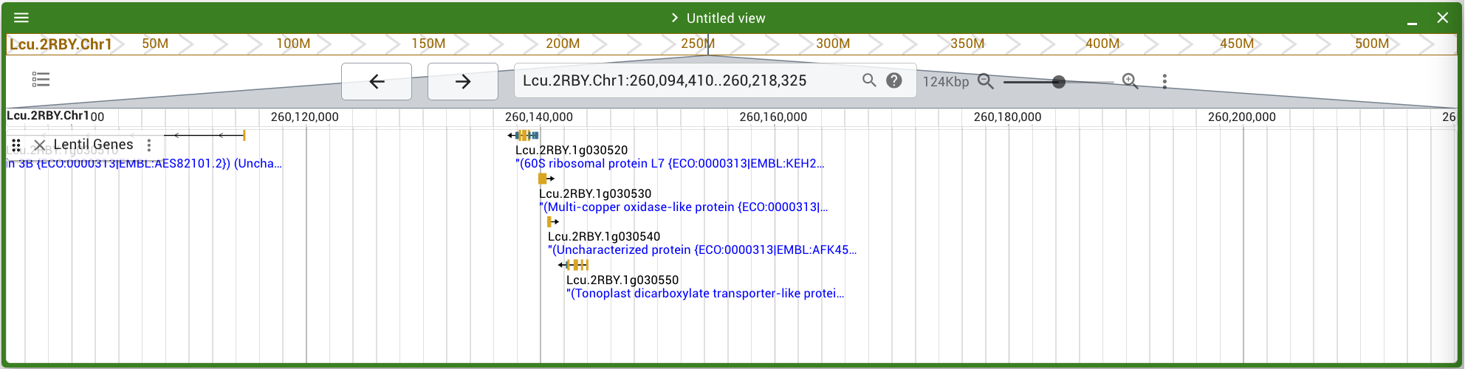
Viewing Synteny

Slide 42
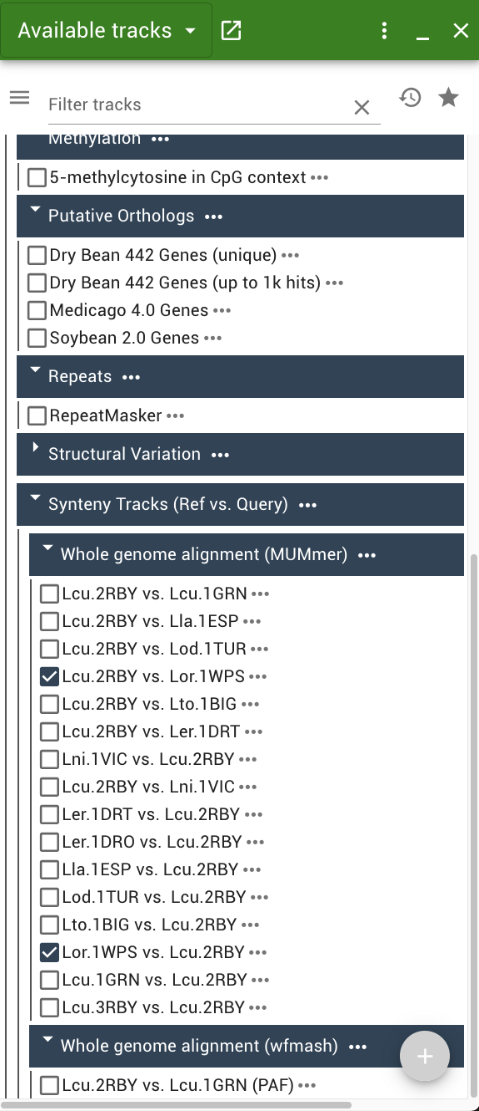
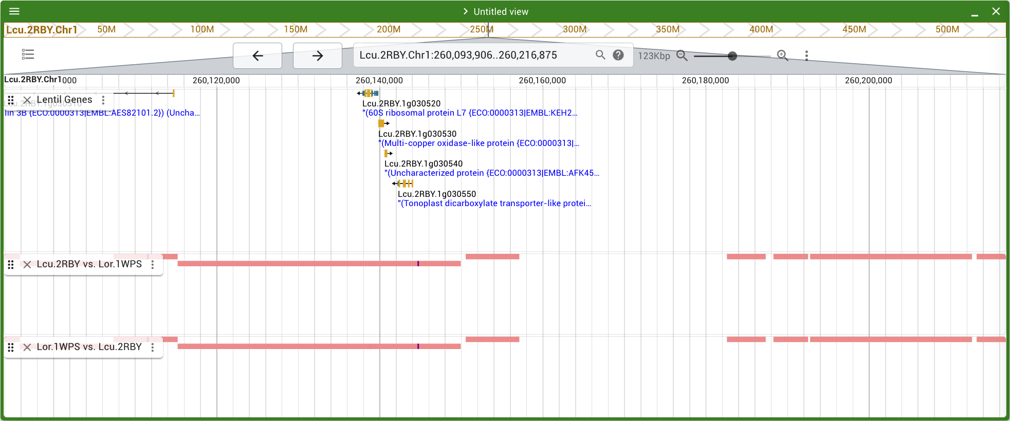
Viewing Synteny

Slide 43
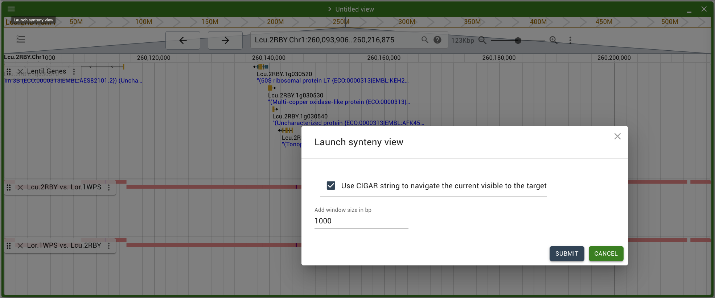
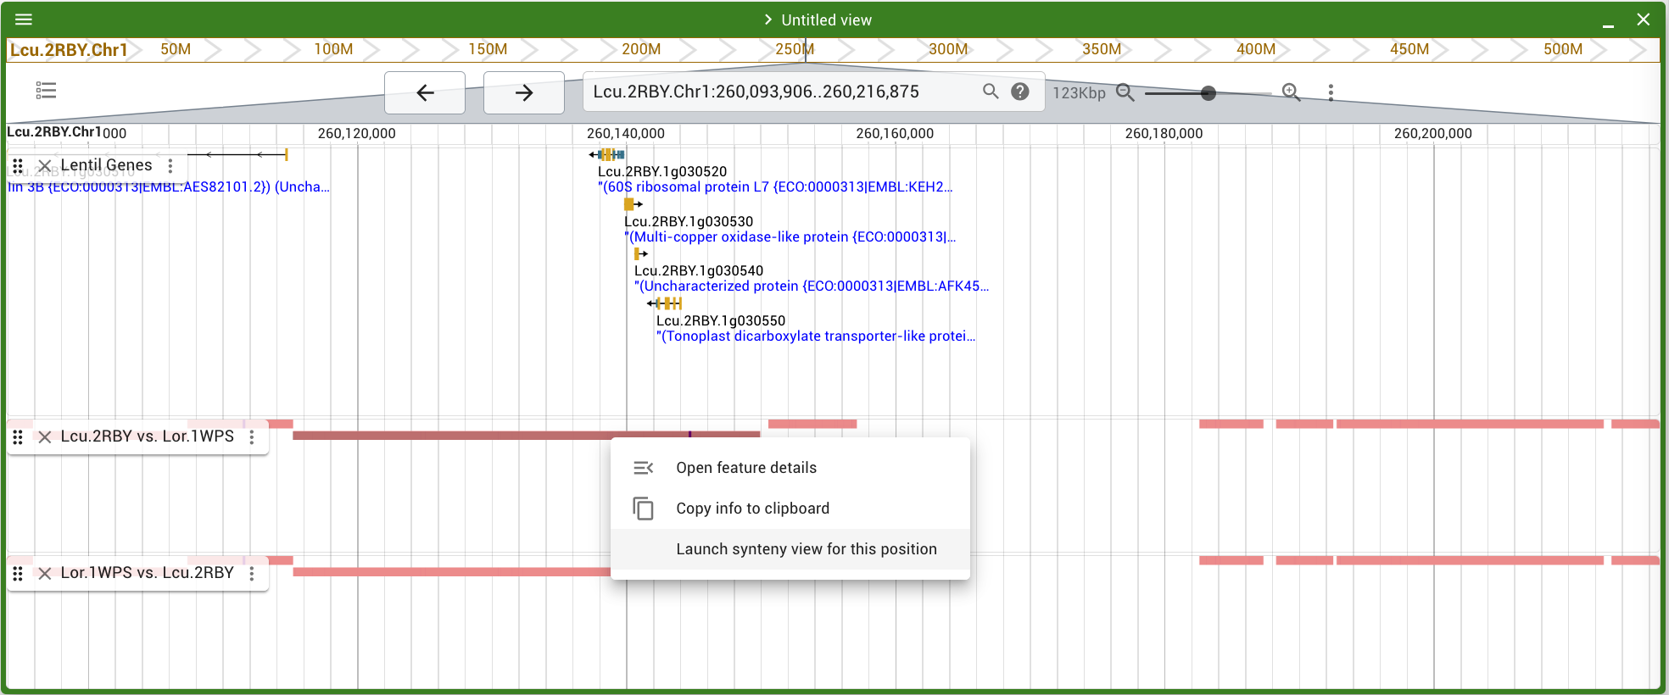
Viewing Synteny

Slide 44
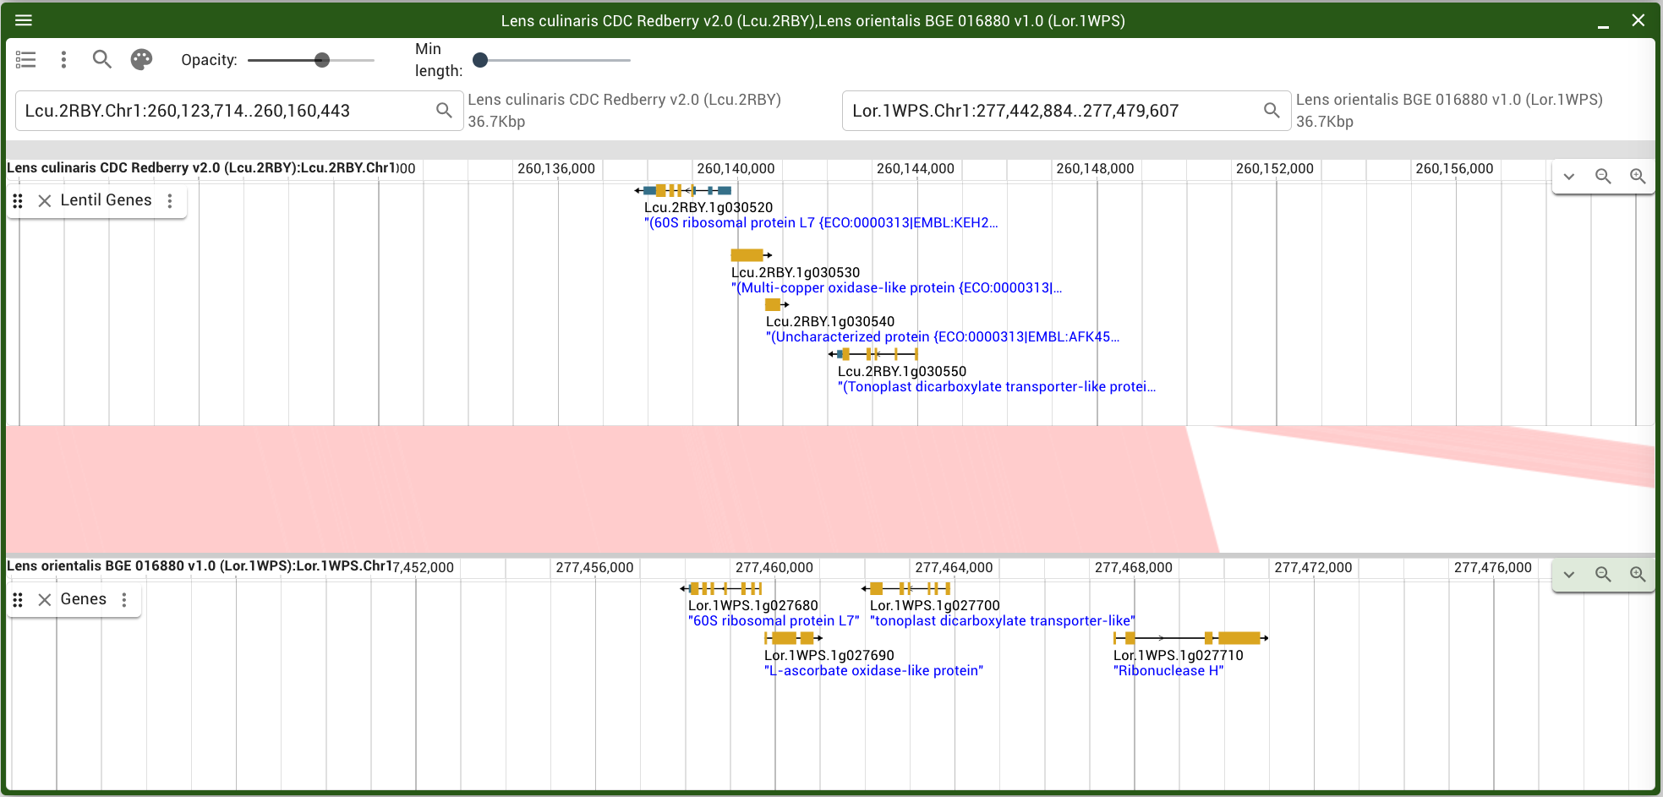
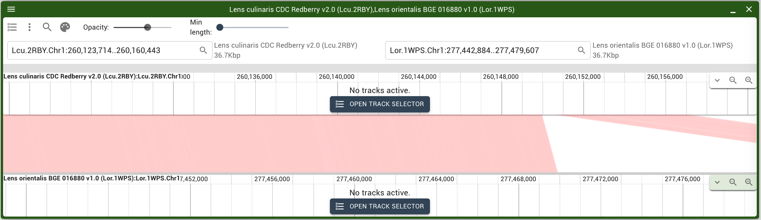
Viewing Synteny

Slide 45
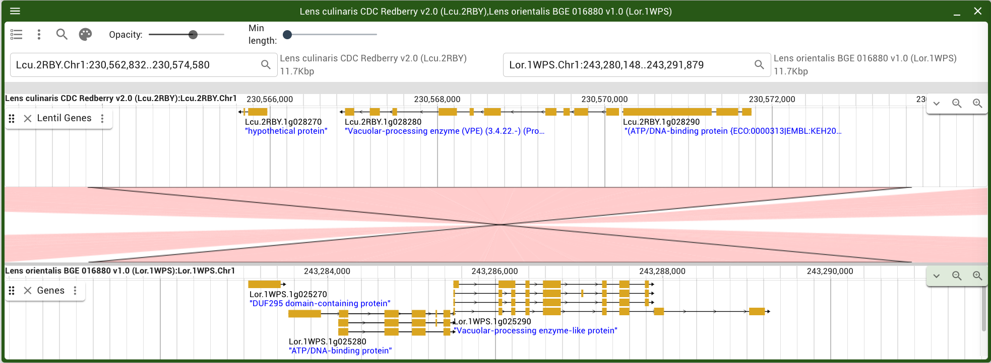

Viewing Synteny
When synteny features are purple, they are on the reverse strand

Slide 46


Viewing Synteny
Viewing a Dotplot View

Slide 47

Viewing Synteny

Slide 48

Tips & Tricks - Undo
If you accidently navigate to a region you didn’t intend to and want to go back, or you accidently closed a track, it is possible to undo!
Using keyboard shortcuts “Ctrl+Z” on Windows or “Command+Z” on Mac
Undo or Redo options are found under “Tools”

Slide 49


Tips & Tricks - Workspaces
NEW!
Workspaces allow you to have open multiple JBrowses in a session so that you don’t need use multiple tabs or windows using your internet browser.
Make sure “Workspaces” is checked off under “Tools”. You’ll know it’s enabled when you see a black bar:

Slide 50

Tips & Tricks - Workspaces
New Empty Tab

Slide 51

Tips & Tricks - Workspaces
New Empty split horizontal

Slide 52

Tips & Tricks
New Empty split vertical
NOTE! If you start a new session by going to “File”, all tabs and windows in the current workspace will disappear.

Slide 53

Tips & Tricks - Bookmarks
At any point, you can highlight a region and choose to bookmark it for later

Slide 54


Tips & Tricks - Bookmarks
At any point, you can highlight a region and choose to bookmark it for later

Slide 55

Tips & Tricks - Bookmarks

Slide 56

Tips & Tricks – Genome Hub
If you’re looking for other species to view in JBrowse, try the new Genome Hub from the jbrowse.org website:

Slide 57

Tips & Tricks – Genome Hub
Or directly to genomes.jbrowse.org

